Slide 1
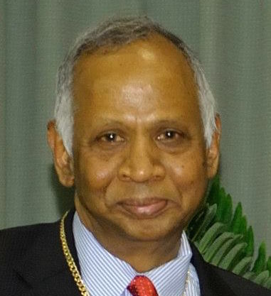
ICWaR Seminar Series
“Mega-trends in the Growth of Hydrologic Understanding: From Newton to Darwin to Wegener”
Prof. Murugesu Sivapalan
Chester & Helen Siess Professor of Civil and Environmental Engineering
Professor of Geography and Geographical Information Science,
University of Illinois at Urbana-Champaign
Satish Dhawan Visiting Chair Professor, ICWaR, IISc
Monday, 18th November 2019, 4 pm
Lecture Hall, ICWaR
Indian Institute of Science
Abstract:
Hydrologic science has undergone transformative changes over the past 100 years, from early empirical approaches to rigorous approaches based on the fluid mechanics of water movement on and below the land surface. Challenged by limitations of traditional Newtonian approaches, and embracing a Darwinian, co-evolutionary Earth system science perspective, the pursuit of hydrologic science is now guided by altogether new questions and methodologies, with a particular focus on interactions and feedbacks between parts of the Earth system that co-evolve, giving rise to the adoption of comparative hydrology. In the emergent Anthropocene, this co-evolutionary view has expanded to involve feedbacks with human-social processes as well. Hydrologic science is now entering a globalization era with a focus on new phenomena that emerge from regional and global teleconnections of the expansion of the human footprint, calling for the adoption of novel Wegenerian approaches to understand the Earth system and the role of water in it. In this lecture, I will present key milestones in the transformation of hydrologic science from Engineering Hydrology to Earth System Science.
Murugesu Sivapalan holds a B.Sc Civil Engineering (University of Ceylon), M.Eng in Water Resources Engineering (AIT, Thailand), and obtained his 1986 Ph.D from Princeton University. He was Professor of Environmental Engineering at the University of Western Australia for 17 years, before joining University of Illinois in 2005. Siva has published on a wide range of topics, including effects of heterogeneity and scale, flood frequency, eco-hydrology and water balance and water quality modeling. He was Executive Editor of the Hydrology and Earth System Sciences journal, and was founding chair of the International Association of Hydrological Sciences’ Decade on Predictions in Ungauged Basins initiative. He is also co-founder of the new subfield of socio-hydrology. Sivapalan has received several awards for his research contributions, including the John Dalton and Alfred Wegener Medals of the European Geosciences Union, the Robert Horton Medal of the American Geophysical Union and the International Hydrology Prize of the International Association of Hydrological Sciences. Sivapalan was awarded the Prince Sultan Bin Abdulaziz International Prize for Water (Creativity Prize) in recognition of his role in developing and leading the new field of socio-hydrology. He is a Fellow of the Australian Academy of Technology and Engineering and recipient of the Centenary Medal of the Australian Government for service to hydrology and Environmental Engineering. He is currently visiting ICWaR as Satish Dhawan Visiting Chair Professor.
Interdisciplinary Centre for Water Research,
Indian Institute of Science, Bangalore

